Slide 1
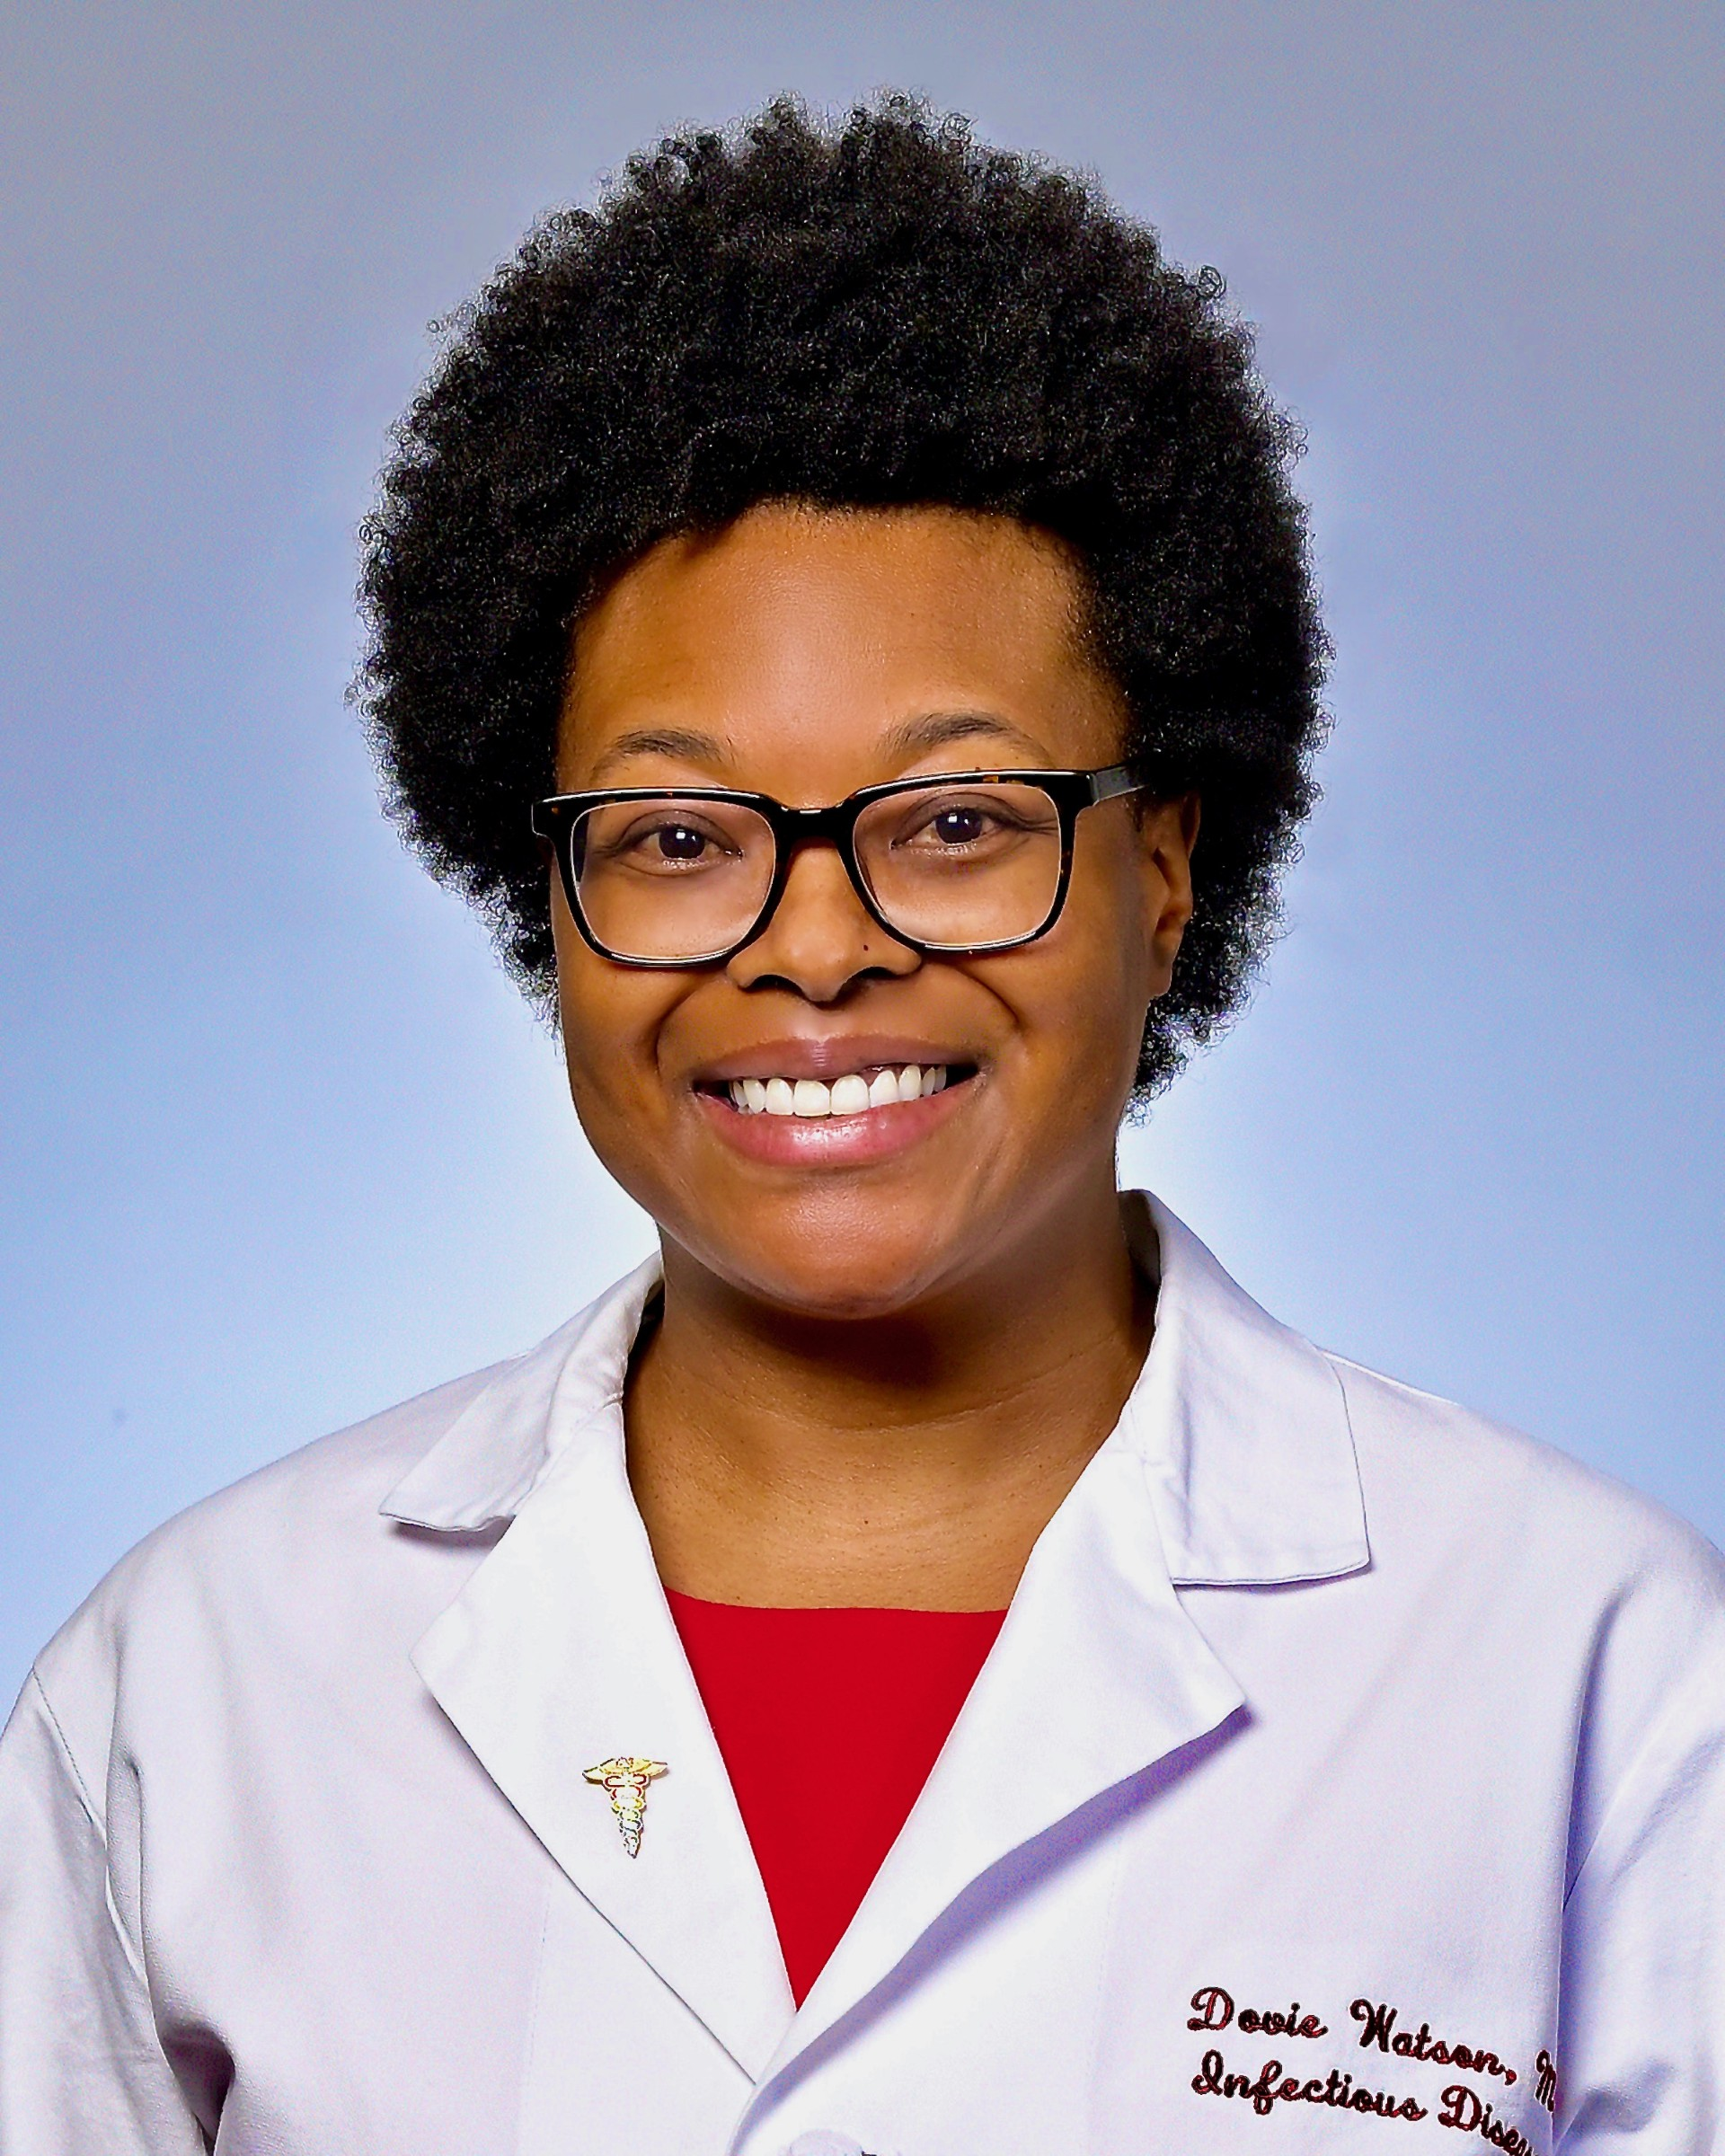
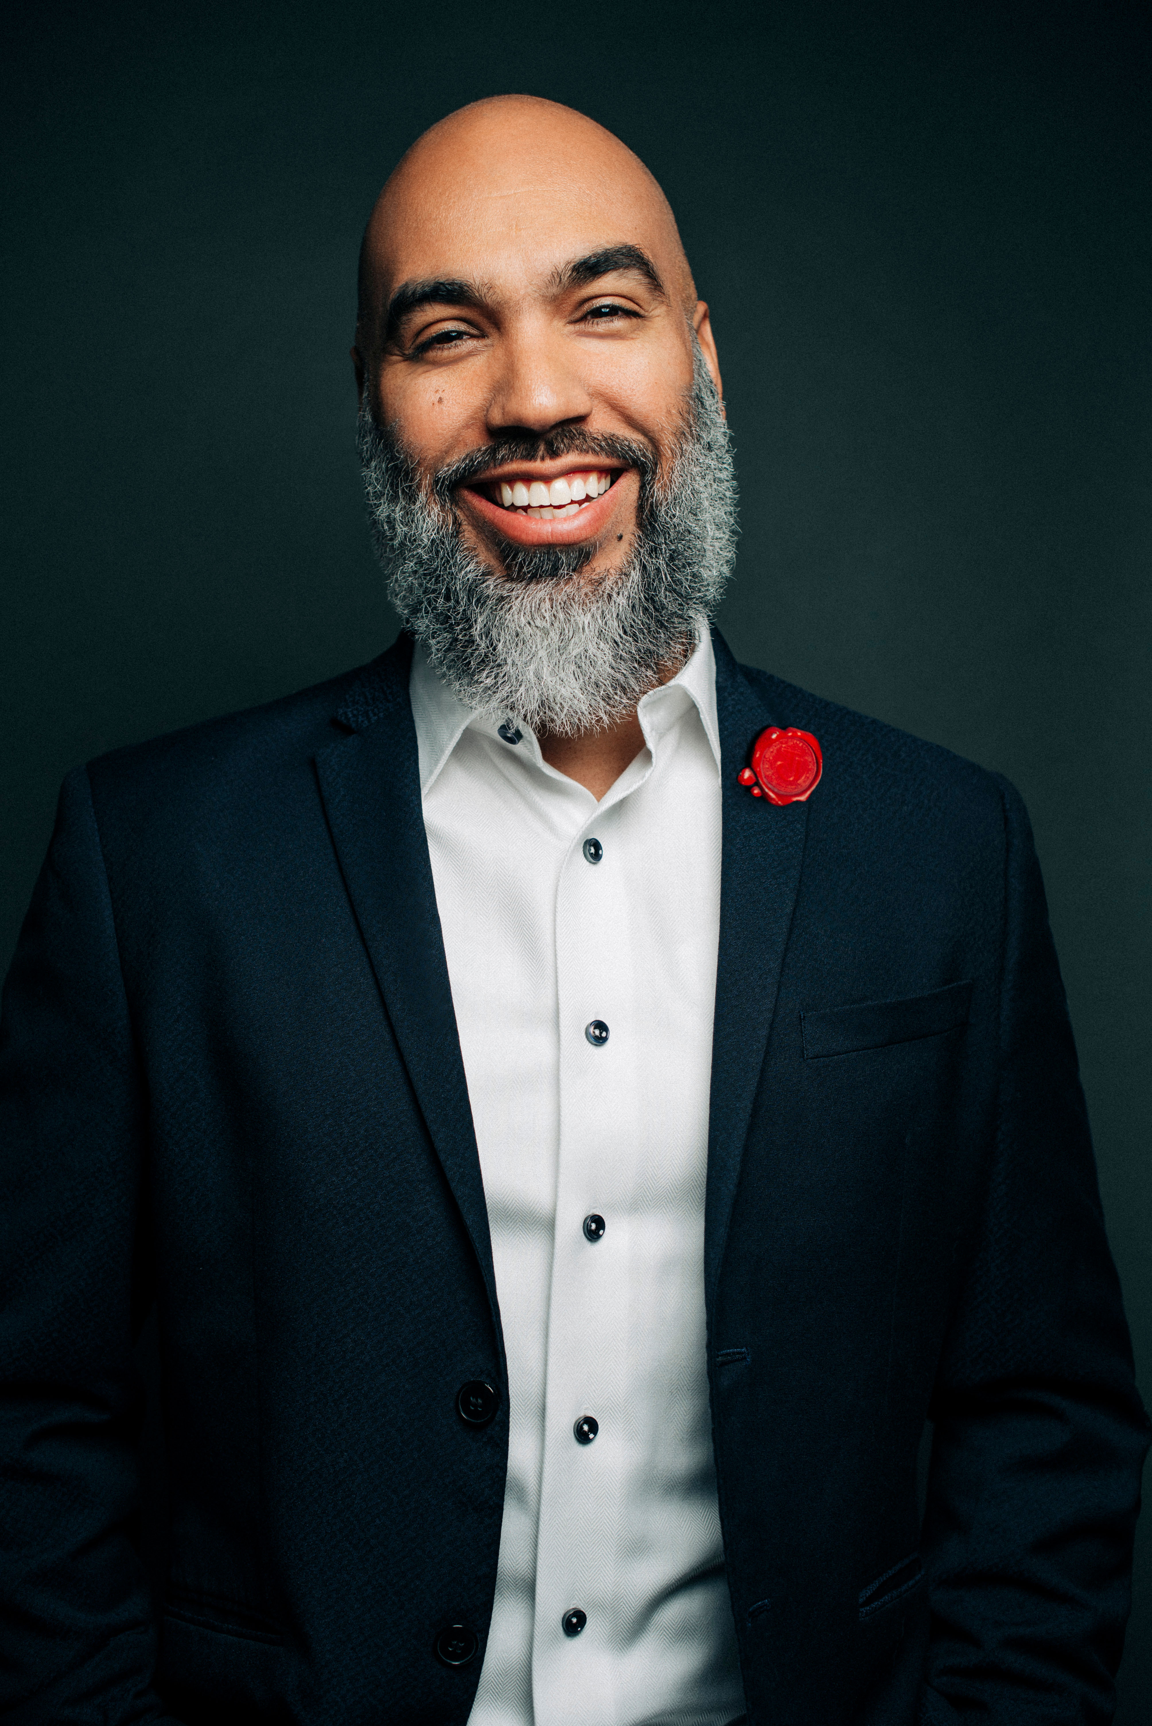
Introducing
Dovie Watson MD, MSCE
Infectious disease physician-scientist
Penn Medicine
Tyrik Jackson
Founder
Premier Barber Institute
Supported by an educational grant from Gilead Sciences, Inc
FADE OUT HIV | AN ALLIANCE BETWEEN BARBERS AND CLINICIANS
Notes:
We want to introduce you to an exciting collaboration between barbers and health care workers to stop HIV within our communities.
We must agree that the rates of HIV transmission within Black and Brown men and women are too high and need to decrease. We need to Fade Out HIV.
Let’s hear first from Mr. Tyrik Washington, founder of Premier Barber Institute

Slide 2
Tyrik Jackson Founder, Premier Barber Institute

Slide 3
Barbers are Trusted and Important Partners
Barbers are trusted by the community for all sorts of information, including health care
Many people do not trust their health care providers and do not believe what they are told about disease, prevention, and treatment

Slide 4
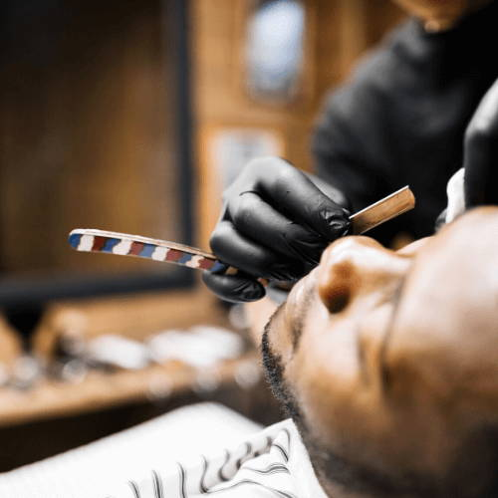
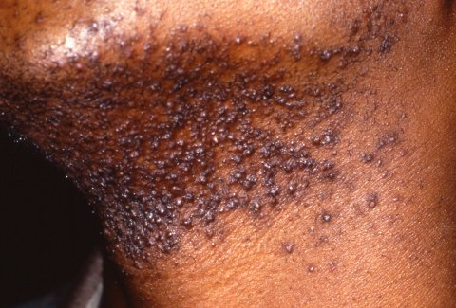
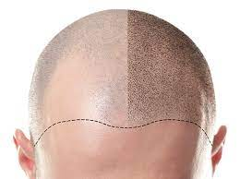
Occupational Exposure to HIV
Shaving
Folliculitis
Scalp micropigmentation
Cuts
Open wounds
Universal precautions
Infection of follicle
Tools and implements
Universal precautions
Sharp needles, tools, and implements
Breaking the skin
Contaminated needles
Universal precautions
Excessive precautions can be stigmatizing!
4

Slide 5
Dovie Watson, MD, MSCE, AAHIVS Infectious Diseases Penn Medicine
Notes:
One of the final pieces of the puzzle is the science. What medicines or interventions are available that can help us Fade Out HIV? Dr. William D. King, a local physician and HIV specialist will help us answer these questions

Slide 6
HIV in the United States (2022)
1.2 million people in the US are living with HIV
HIV affects people of all races, ethnicities, ages, genders, and sexual orientations
More than one-third (435,000) of people living with HIV in the US are Black/African American
About 25% are White and 22% are Hispanic
13% in US overall are unaware of their diagnosis
~38,000 cases new cases annually
FADE OUT HIV | AN ALLIANCE BETWEEN BARBERS AND CLINICIANS
Notes:
Centers for Disease Control and Prevention. NCHHSTP AtlasPlus. https://www.cdc.gov/nchhstp/about/atlasplus.html. Accessed August 6, 2024

Slide 7
HIV Affects Some People More Than Others
All people are affected by HIV
Black Americans are disproportionately affected by HIV, making up 40% of new HIV infections
Social and structural issues--such as HIV stigma, discrimination, poverty, and limited access to health care--drive inequities
https://www.cdc.gov/hiv/library/reports/hiv-surveillance/vol-32/content/figures.html
Notes:
Centers for Disease Control and Prevention. NCHHSTP AtlasPlus. https://www.cdc.gov/nchhstp/atlas/index.htm. Accessed August 6, 2024

Slide 8
How People Get HIV in US (2022)
Occupational exposure is very low
https://www.cdc.gov/hiv/library/reports/hiv-surveillance/vol-32/content/figures.html
FADE OUT HIV | AN ALLIANCE BETWEEN BARBERS AND CLINICIANS
Notes:
58 confirmed cases of HIV transmission to HCW in US (1 since 1999) according to https://www.cdc.gov/hiv/workplace/healthcareworkers.html
Centers for Disease Control and Prevention. NCHHSTP AtlasPlus. https://www.cdc.gov/nchhstp/atlas/index.htm. Accessed August 6, 2024

Slide 9
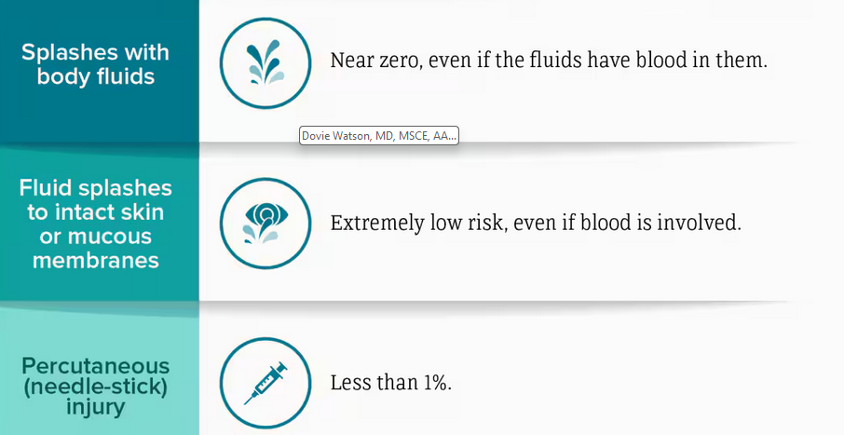
Low Risk of HIV
Wendy, please redraw in our style/colors
Notes:
https://www.cdc.gov/hiv/workplace/healthcareworkers.html

Slide 10
Preventing HIV
Testing for HIV is recommended for everybody; it is simple and takes minutes
HIV can be prevented with PrEP (pre-exposure prophylaxis)
One pill every day or injections every two months
99% effective at reducing HIV transmission via sex
Does not prevent other STIs

Slide 11
Treating HIV
Testing for HIV is recommended for everybody; it is simple and takes minutes
HIV medications are now very effective and easy to take
One pill every day for most people or injections every two months
People living with HIV who take their medication consistently can live nearly as long as people without HIV
Treatment can also prevent transmission of HIV

Slide 12
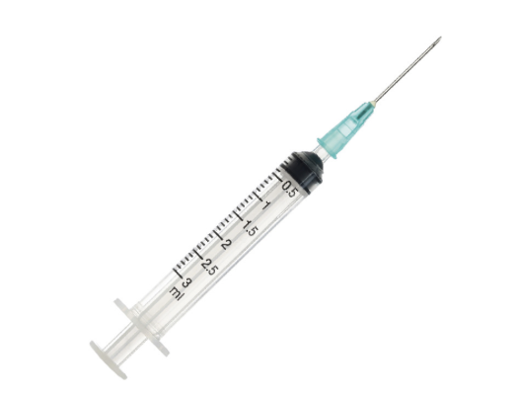
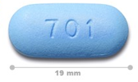
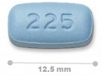
Current Medications for PrEP
Truvada
TDF/emtricitabine
For all sexually active people
Used to prevent HIV from injection drug use
Generic available
Descovy
TAF/emtricitabine
Fewer side effects
Approved to prevent HIV from sex*
Smaller pill size
Apretude
Cabotegravir long-acting
For all sexually active people
Injection every two months
FADE OUT HIV | AN ALLIANCE BETWEEN BARBERS AND CLINICIANS
12
Notes:
PrEP reduces risk of HIV by 99% when taken as prescribed

Slide 13
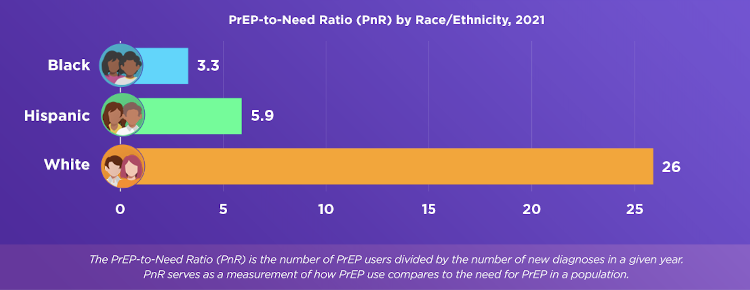
Who is Using PrEP by Race
https://prepvu.org
FADE OUT HIV | AN ALLIANCE BETWEEN BARBERS AND CLINICIANS
13
Notes:
https://prepvu.org/news/aidsvu-releases-new-prep-data-and-launches-prepvu-org-a-new-prep-equity-platform/

Slide 14
Barriers to Health Equity
Higher rates of STIs
Lower access to health care
Smaller sexual networks
Lack of knowledge of status
Mistrust of the health care system
Trauma (eg, childhood sexual abuse)
Lack of health care provider knowledge
PrEP/HIV stigma
Racism
Homophobia
Poverty
https://www.cdc.gov/hiv/group/racialethnic/africanamericans/index.html; https://www.kff.org/hivaids/fact-sheet/black-americans-and-hivaids-the-basics/#footnote-448622-7; Mustanski et al. JAIDS. 2019;80:24-30.
14
Notes:
https://www.cdc.gov/hiv/group/racialethnic/africanamericans/index.html
https://www.kff.org/hivaids/fact-sheet/black-americans-and-hivaids-the-basics/#footnote-448622-7
Mustanski B, Morgan E, D’Aquila R, et al. Individual and network factors associated with racial disparities in HIV among young men who have sex with men: results from the RADAR Cohort Study. JAIDS 2019;80:24-30
REFS
https://www.cdc.gov/hiv/group/racialethnic/africanamericans/index.html; https://www.kff.org/hivaids/fact-sheet/black-americans-and-hivaids-the-basics/#footnote-448622-7; Mustanski et al. JAIDS. 2019;80:24-30.

Slide 15
How to Stop HIV
U = U

Slide 16
Tyrik Jackson

Slide 17
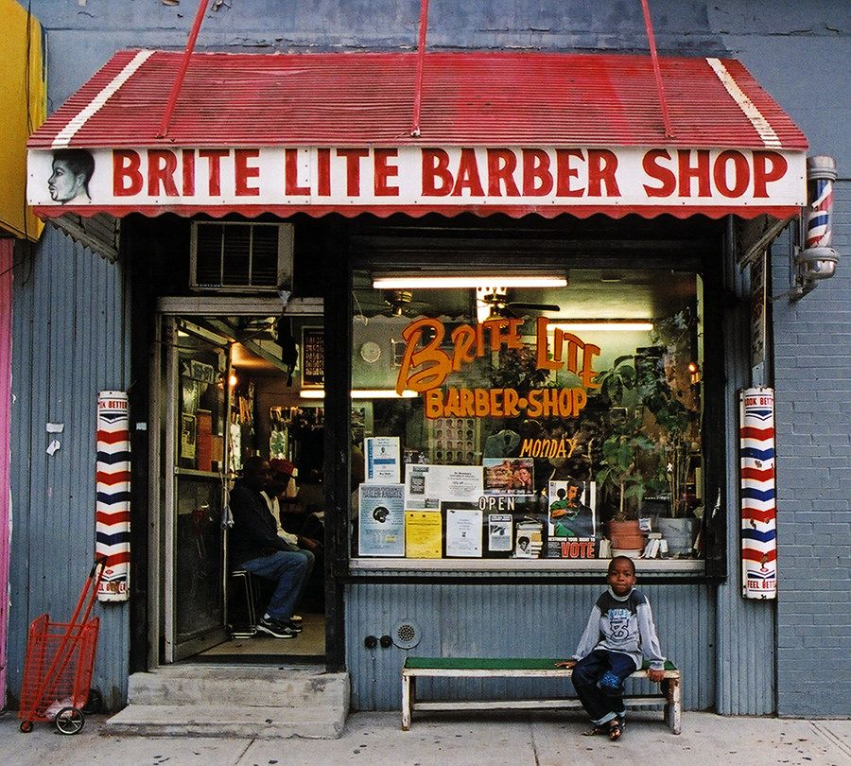
Barbers…Let’s Start the Change!
Barbers are a staple in the Black community
The barbershop is a safe space to discuss many topics including current and cultural events, relationships, sex, and health care
Barbers have spread the message about diabetes and high blood pressure
Barbers helped clients reduce their blood pressure by measuring blood pressure and promoting follow-up
Barbers helped identify people with undiagnosed diabetes
17
Notes:
Tyrik may want to put in a few sentences about the role of barbes in the Black Community. Transition into how becoming place just for hair- became trusted community providers . Hx of barbes as surgeons!?

Slide 18
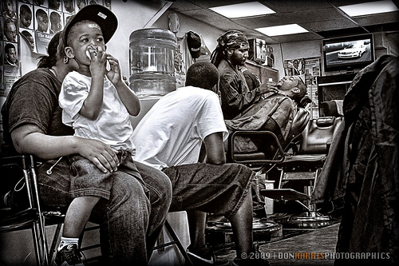
How to Talk with Your Clients
The Club
“Promiscuity”
Types of services
https://www.newblackmaninexile.net/2012/07/tongues-untied-on-barbershop.html

Slide 19
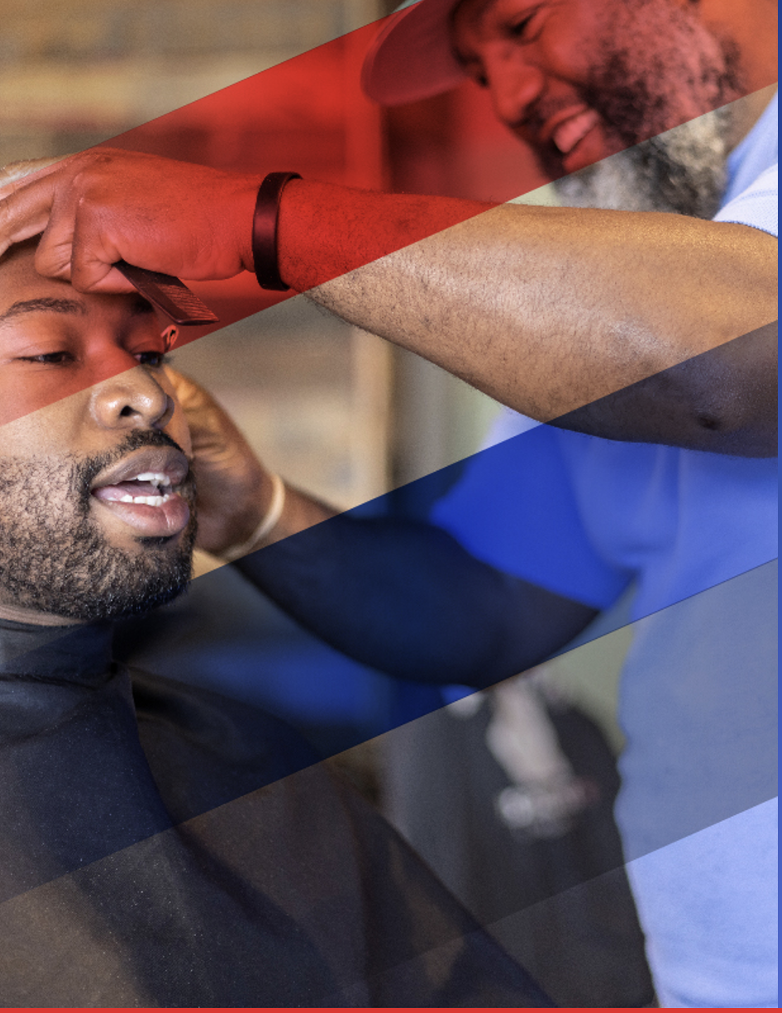
How You Can Help and What You Get Back
You’ll get:
Publicity on social media and possibly local media outlets for the screening event at your shop
Education for you, your staff, and your customers in your barbershop
A list of health care providers in your neighborhood who are committed to the Black community; these providers can screen for HIV and prescribe PrEP to prevent HIV
Your client gets:
A $25 gift card if they get tested
Linkage to care and prevention
Sign up to join us!

Slide 20
HOLD for BEBASHI SLIDE

Slide 21
Helping People Get PrEP
Most insurance plans and state Medicaid programs cover PrEP; prior authorization may be required
Co-pay assistance: income is not a factor in eligibility
https://www.gileadadvancingaccess.com/
https://www.viivconnect.com/patient/get-savings-information/
https://phillykeeponloving.com/teleprep/

Slide 22
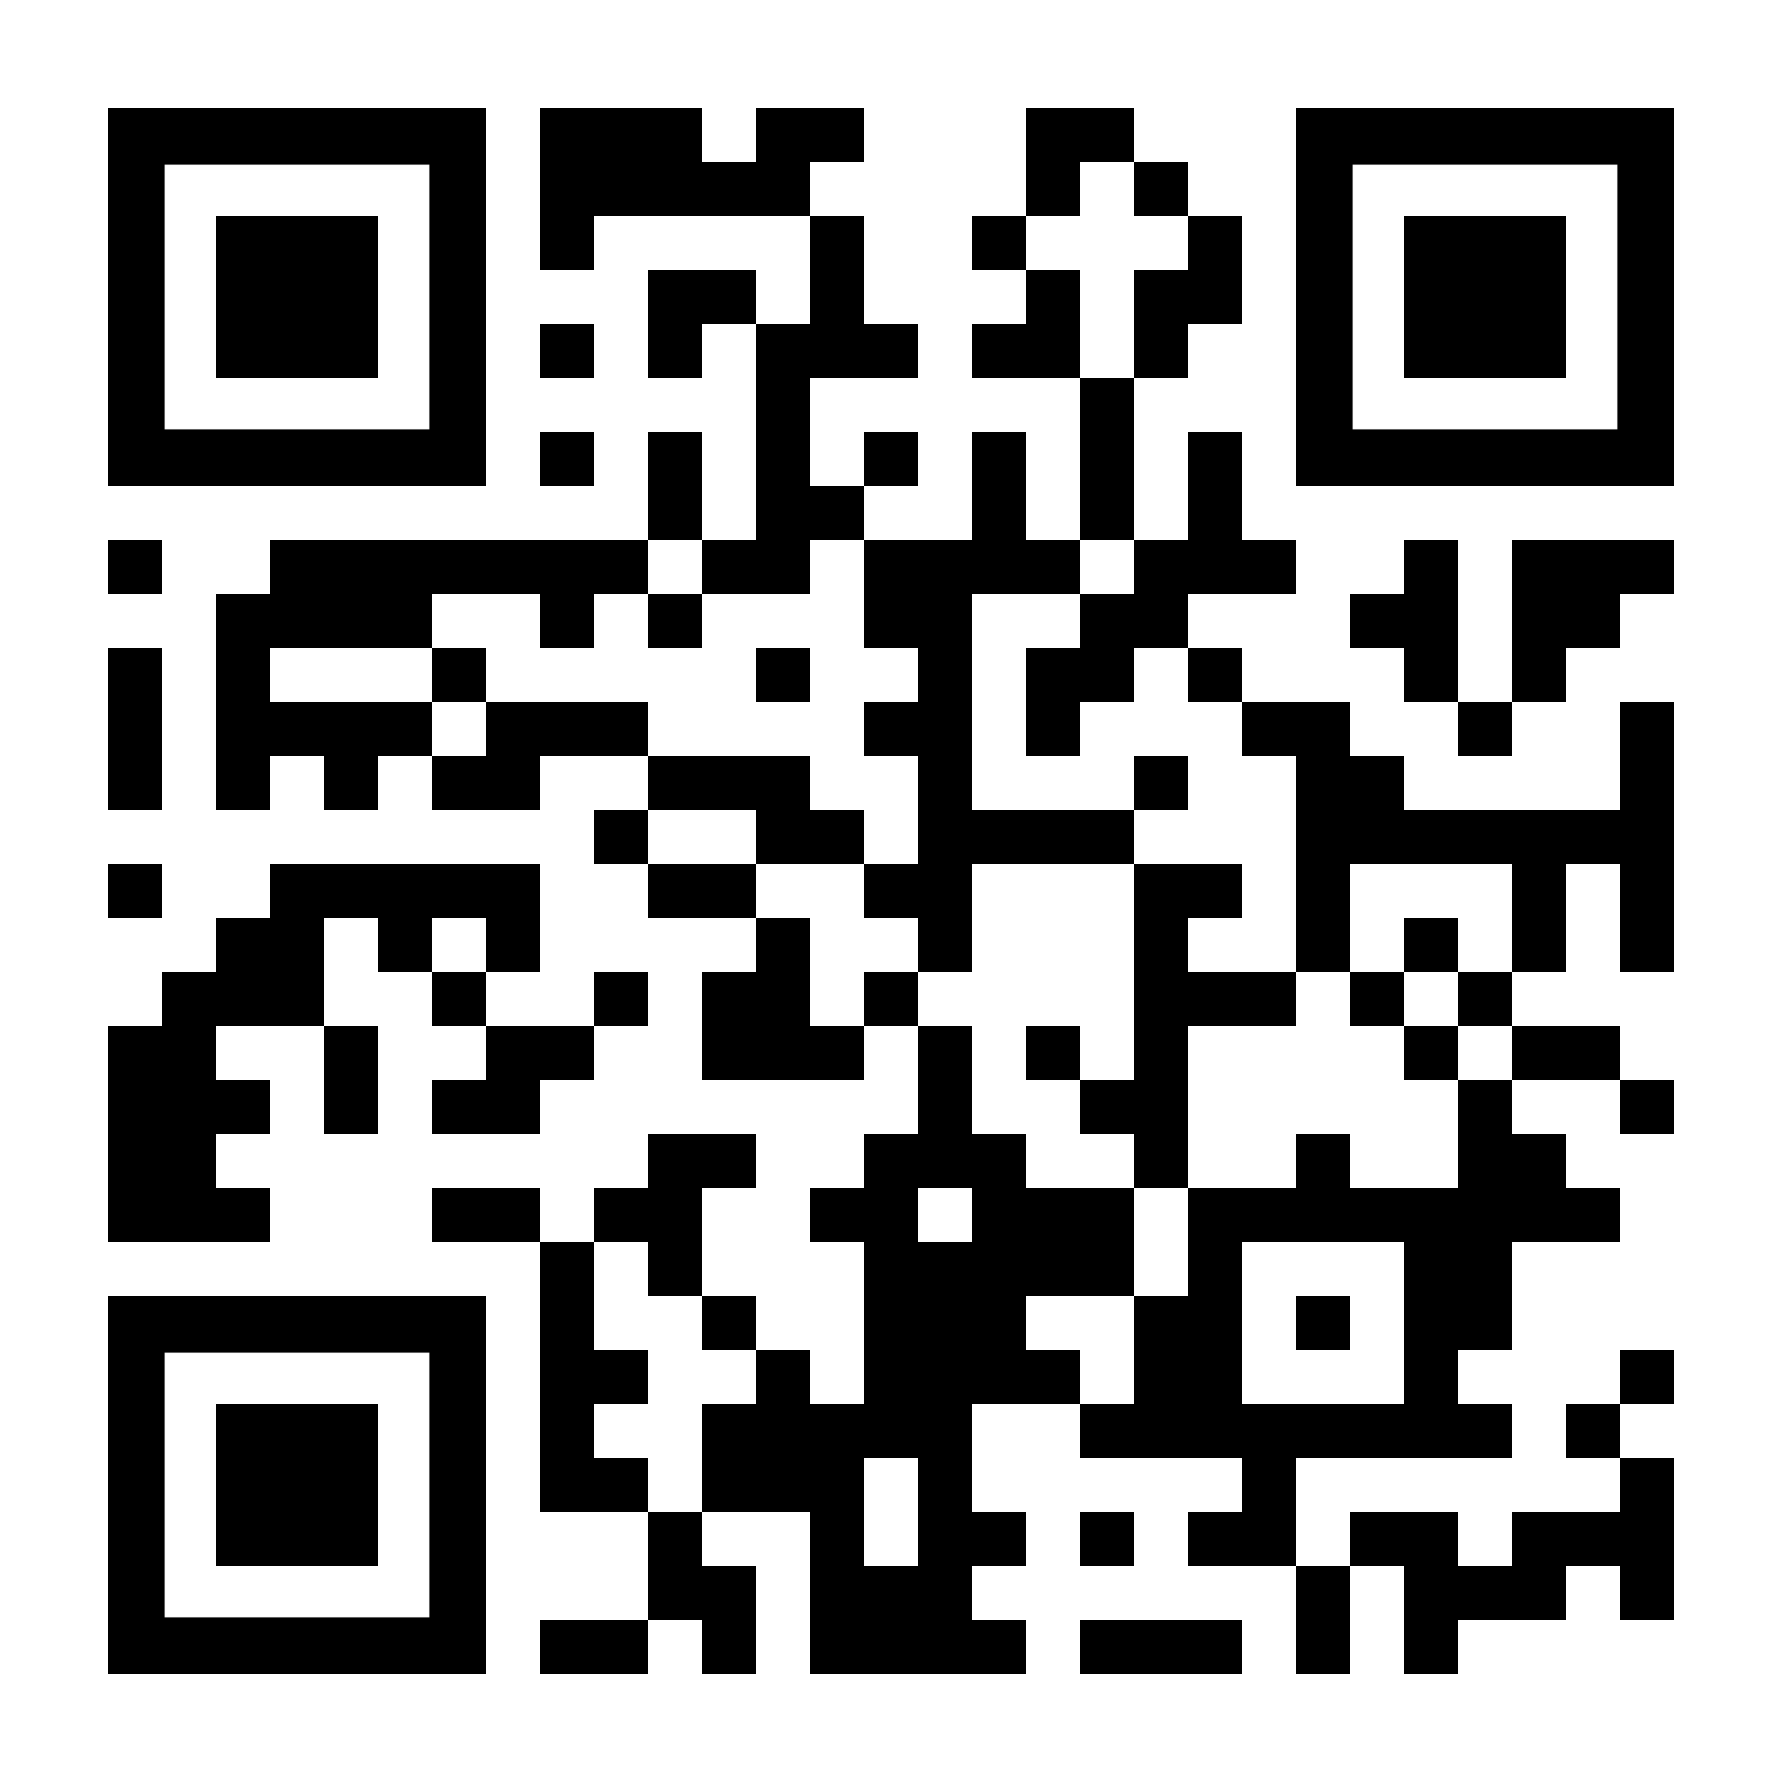
How to Sign Up
You all have a QR Code in your VIP bag
Use the code to sign up or stop by Booth16
It’s vitally important to help prevent the spread of HIV in our community
Will be updated
For questions or for more information, email Tabitha Washington at
twashington@dkbmed.com or go to Barbers.dkbmed.com

Slide 23
Questions?

